Slide 1
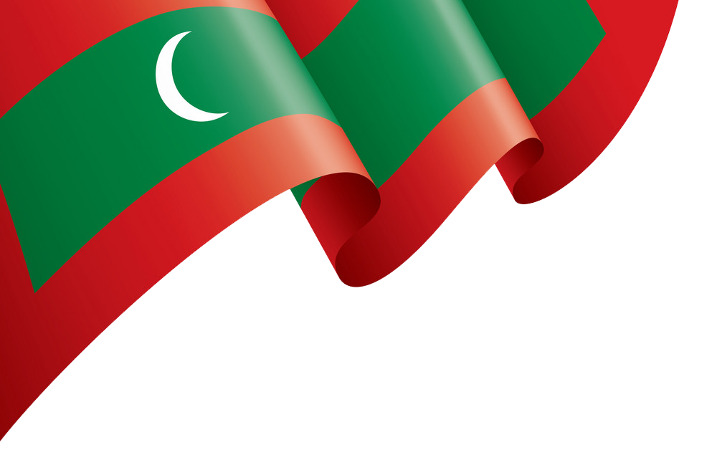
Welcome!
މަރުހަބާ
DHIVEHI LANGUAGE CLASS
ދިވެހި ބަސް ކިލާސް

Slide 2
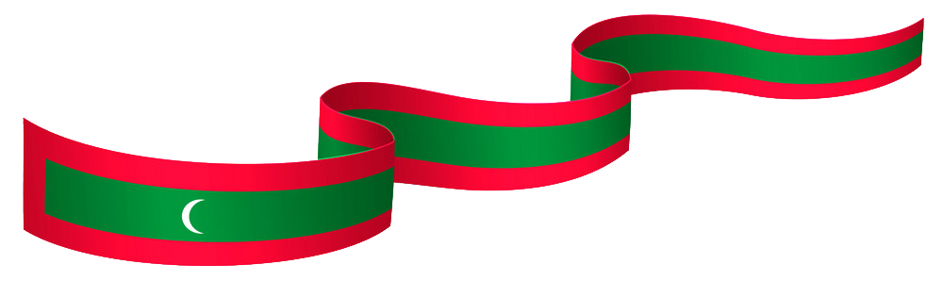
Introduction - Maldivian (ދިވެހި)
Maldivian (Dhivehi) is an Indo-Aryan language.
Spoken in Maldives and Minicoy (Maliku).
Major dialects of Maldivian are Malé, Huvadhu, Mulaku, Addu, Haddhunmathee and Maliku.
The Malé dialect is considered the standard.
Dhivehi language is closely related to Sinhalese.
It has been influenced by and absorbed words from languages such as Arabic, French, Persian, Portuguese, Urdu and English.
Notes:
Maldivian (Dhivehi) is an Indo-Aryan language spoken primarily in the Maldives, and also in India, mainly in Minicoy Island (Maliku), located in the Union territory of Lakshadweep.
Major dialects of Maldivian are Malé, Huvadhu, Mulaku, Addu, Haddhunmathee and Maliku. The Malé dialect is considered the standard.
Maldivian language is closely related to, Sinhalese.
It has been influenced by and absorbed words from languages such as Arabic, French, Persian, Portuguese, Urdu and English.

Slide 3
Dhivehi Alphabets – Thaana (ތާނަ)
މ | ވ | އ | ކ | ޅ | ބ | ރ | ނ | ށ | ހ
Meemu m | Vaavu v | Alifu a | Kaafu k | Lhaviyani lh | Baa b | Raa r | Noonu n | Shaviyani sh | Haa h
ޓ | ޒ | ޑ | ސ | ޏ | ގ | ލ | ތ | ދ | ފ
Taviyani t | Zaviyani z | Daviyani d | Seenu s | Gnaviyani gn | Gaafu g | Laamu l | Thaa th | Dhaalu dh | Faafu f
އޫ | އު | އީ | އި | އާ | އަ | ޗ | ޖ | ޕ | ޔ
Ooboo fili oo | Ubu fili u | Eebee fili ee | Ibi fili i | Aabaa fili aa | Aba fili a | Chaviyani ch | Javiyani j | Paviyani p | Yaa y
 |  |  |  |  | އް | އޯ | އޮ | އޭ | އެ
 |  |  |  |  | Sukun ‘ | Oaboa fili oa | Obo fili o | Eybey fili ey | Ebe fili e

Slide 4
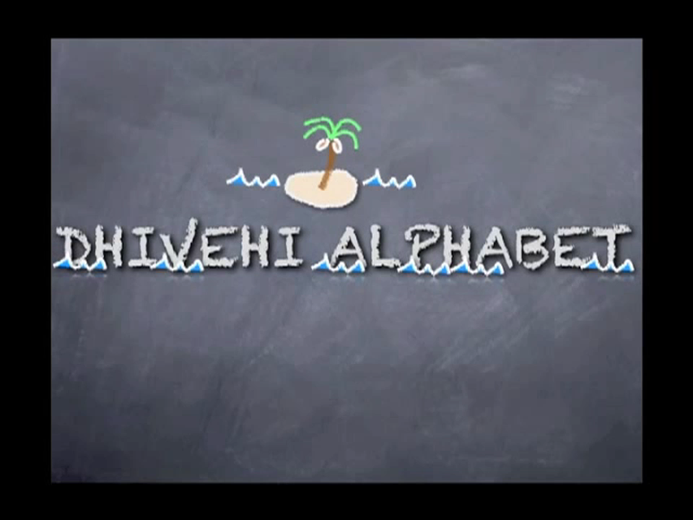
Dhivehi Alphabets – Thaana (ތާނަ)

Slide 5
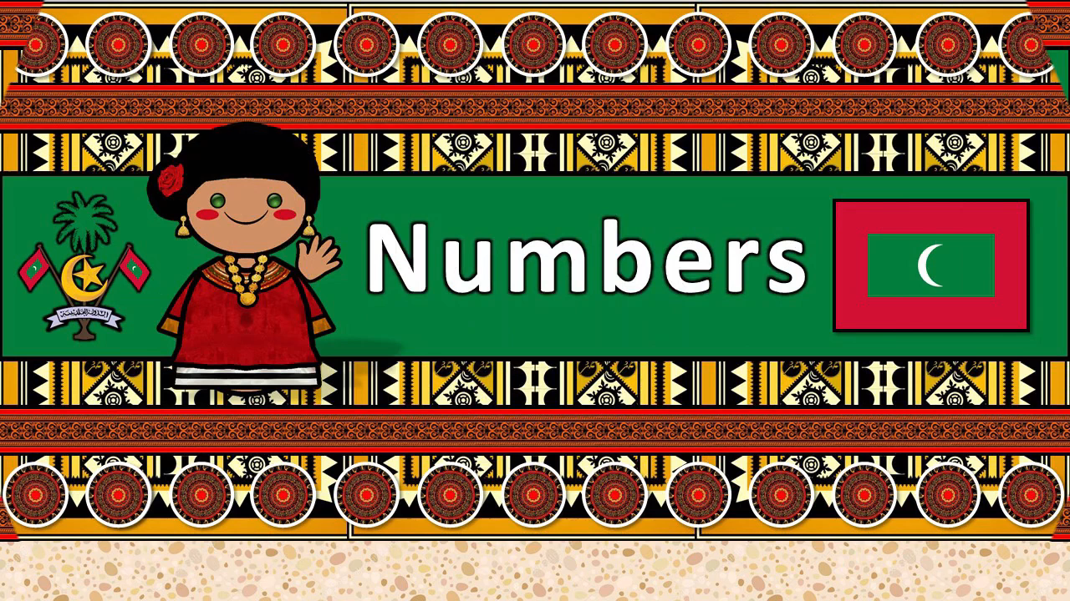

Slide 6
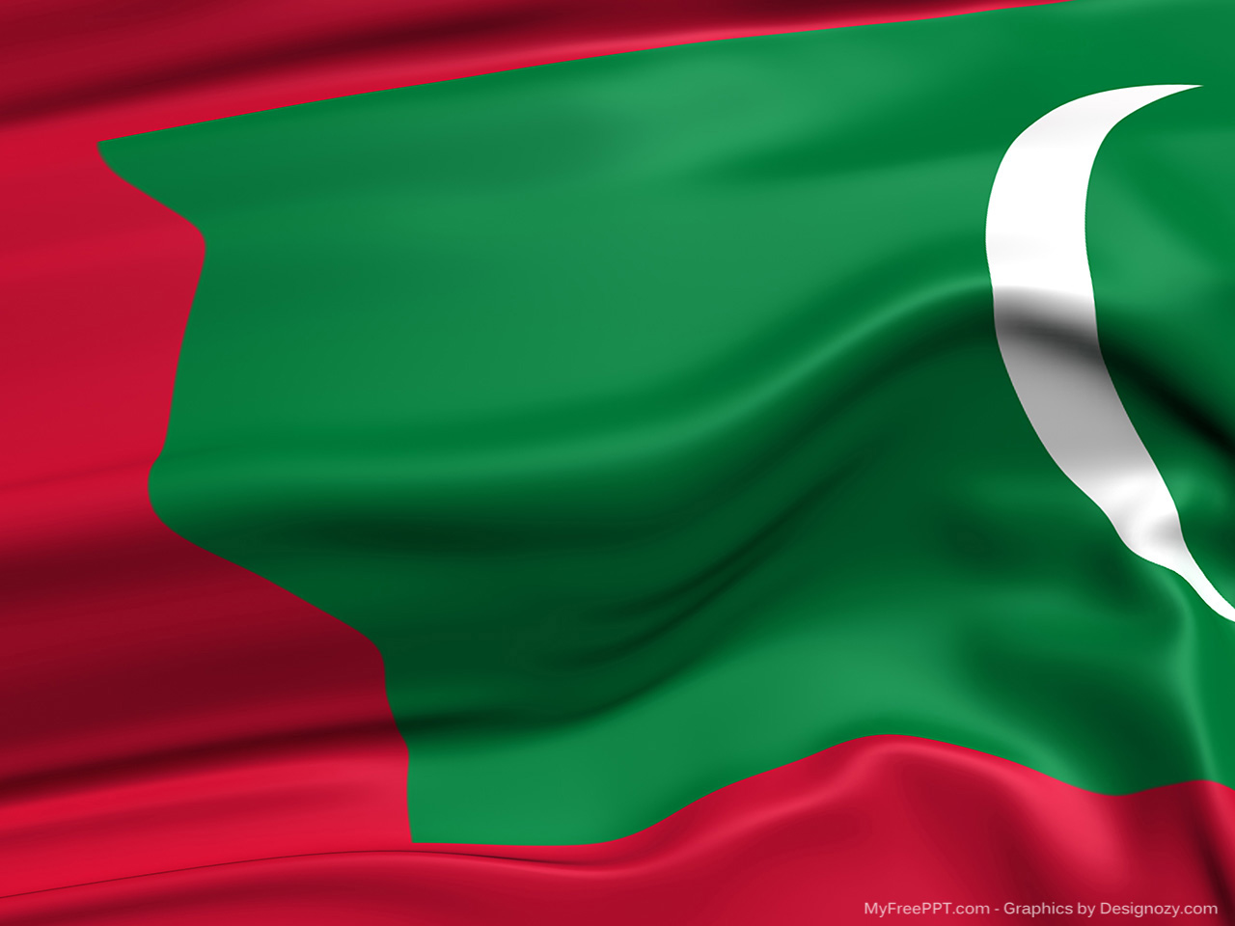
Thank you

